Slide 1
CS6456: Graduate Operating Systems
Brad Campbell – bradjc@virginia.edu
https://www.cs.virginia.edu/~bjc8c/class/cs6456-s20/

Slide 2
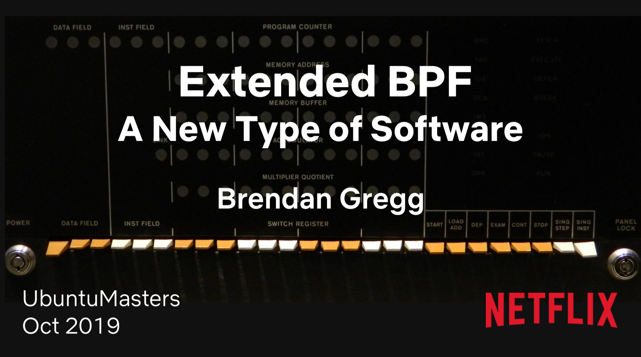

Slide 3
New Kernel Software Abstractions: BPF
“BPF is the biggest operating systems change I've seen in my career, and it's thrilling to be a part of it.” - Brendan Gregg, Netflix
http://www.brendangregg.com/blog/2019-12-02/bpf-a-new-type-of-software.html

Slide 4
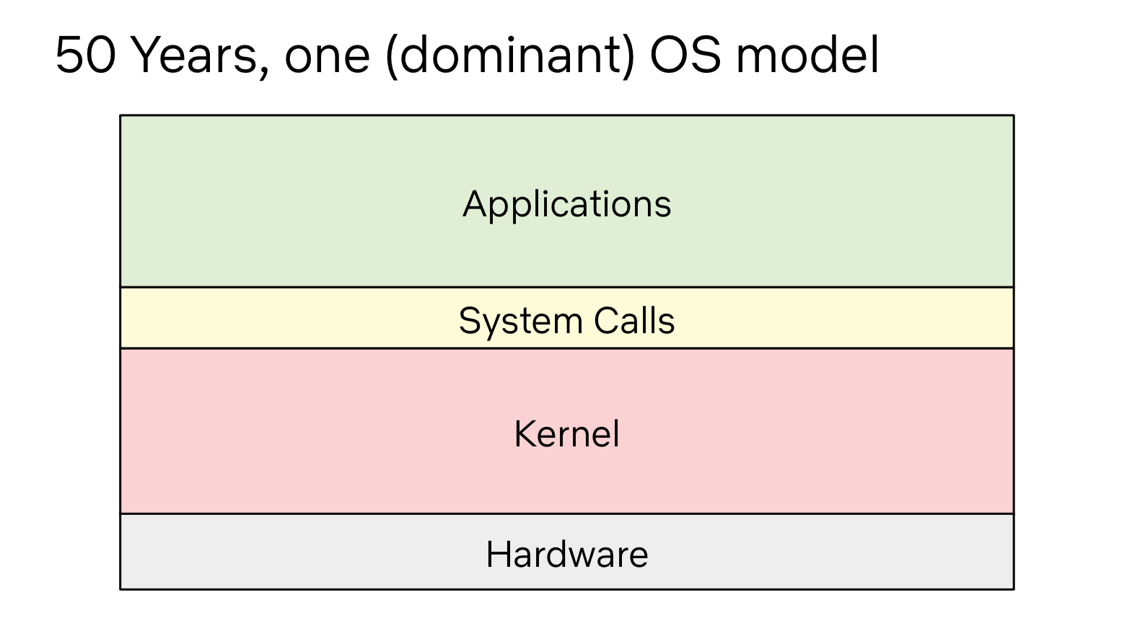

Slide 5
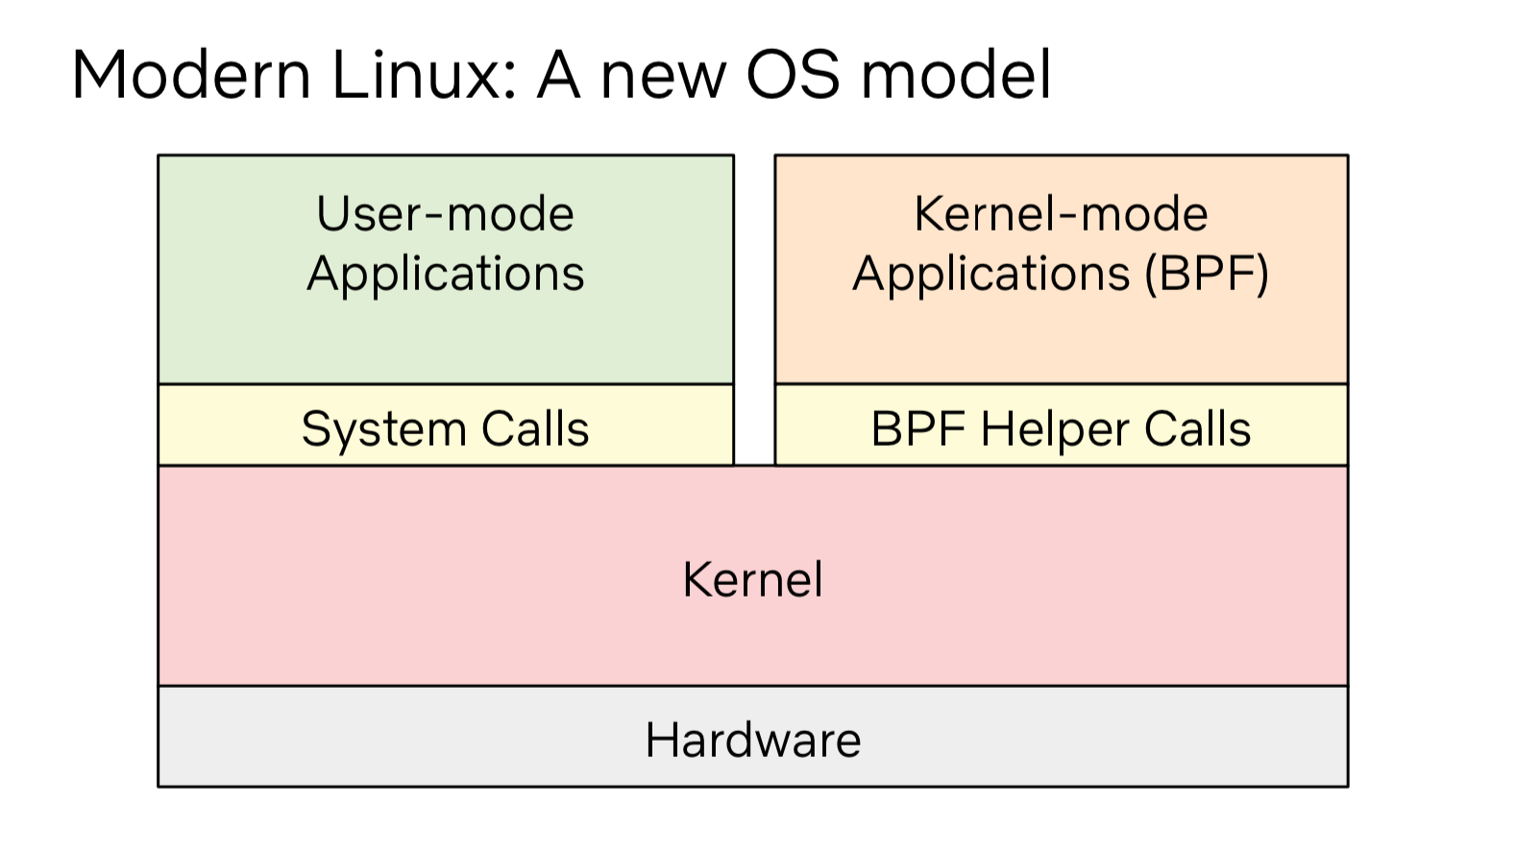

Slide 6
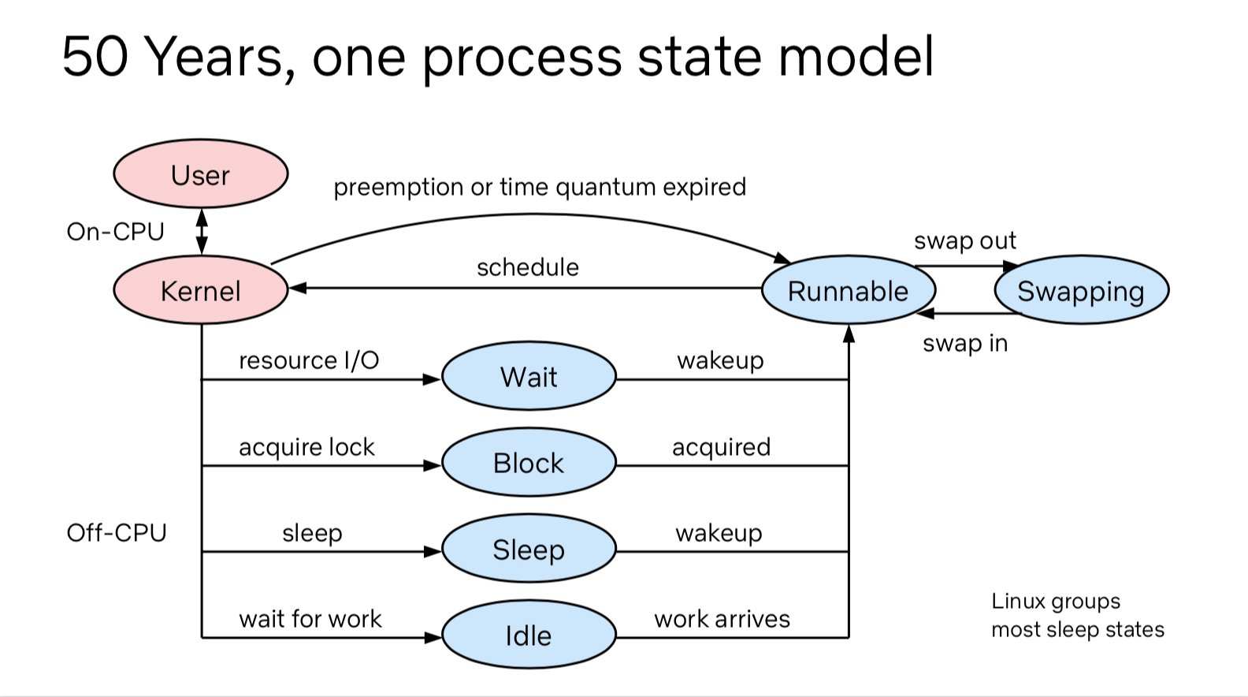

Slide 8
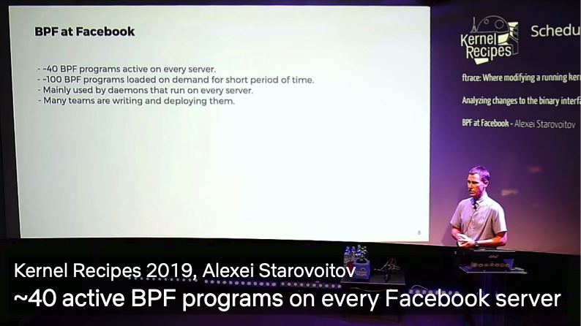

Slide 10
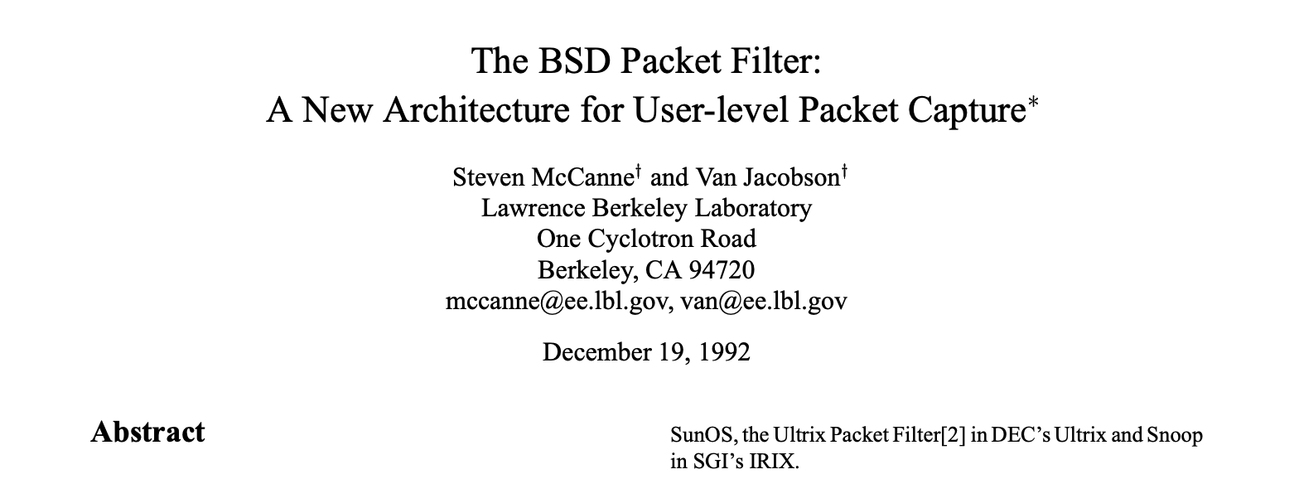
BPF: Where did it start?
Born from a distinct need
LBNL diagnosing failures in the internet
Difficult to get visibility into congestion issues
Wanted an architecture for retrieving certain packets
BPF: Berkeley Packet Filter
Simple instruction set to filter packets
Executed in kernel on incoming packets
No loops
Now called cBPF

Slide 11
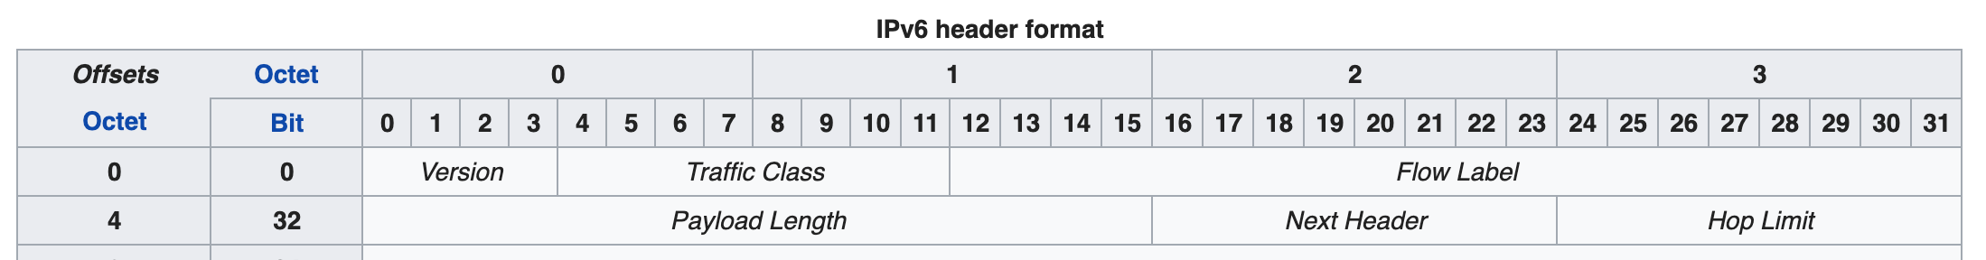
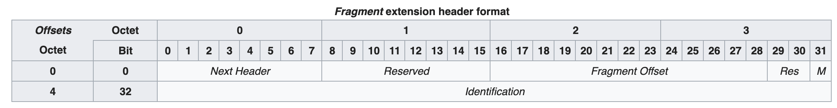
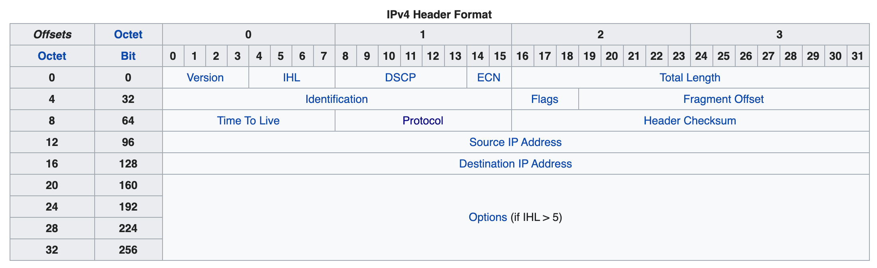
Easy to view a cBPF program
Choose a valid network interface
Ethernet frame
$ tcpdump -d 'tcp' -i en0
(000) ldh [12]
(001) jeq #0x86dd jt 2 jf 7
(002) ldb [20]
(003) jeq #0x6 jt 10 jf 4
(004) jeq #0x2c jt 5 jf 11
(005) ldb [54]
(006) jeq #0x6 jt 10 jf 11
(007) jeq #0x800 jt 8 jf 11
(008) ldb [23]
(009) jeq #0x6 jt 10 jf 11
(010) ret #262144
(011) ret #0
Load half word, at index 12
12
14
If false, jump to line 7
Jump equal to 0x86dd (IPv6)
If true, jump to line 2
Load byte at index 20
Jump equal to 0x6 (TCP)→ success!
jeq 0x2c (v6 frag)
20
Load byte at index 54
Jump equal to 0x6 (TCP)→ success!
Jump equal to 0x0800 (IPv4)
54
Load byte at index 23
Jump equal to 0x6 (TCP)→ success!
Return 0x40000 -> success
23
Return 0 -> fail

Slide 12
2014: eBPF introduced into Linux
Changes from cBPF:
64 bit values
10 registers
More instructions → match hardware
Can call into (some) kernel functions
Why now?
Better static analysis tools
Virtual machines proven indispensable
Today
Userspace API for loading eBPF programs
Clang can compile to eBPF
Several hook points in the kernel (not just networking)

Slide 15
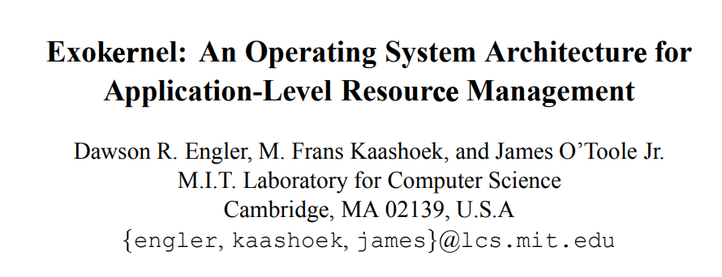
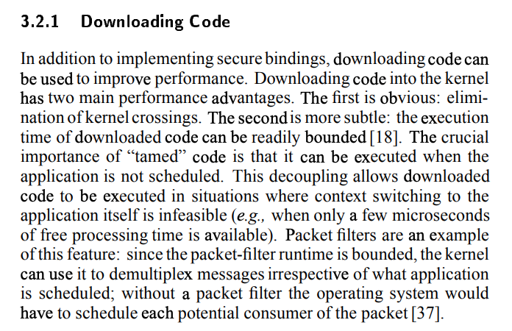

Slide 17
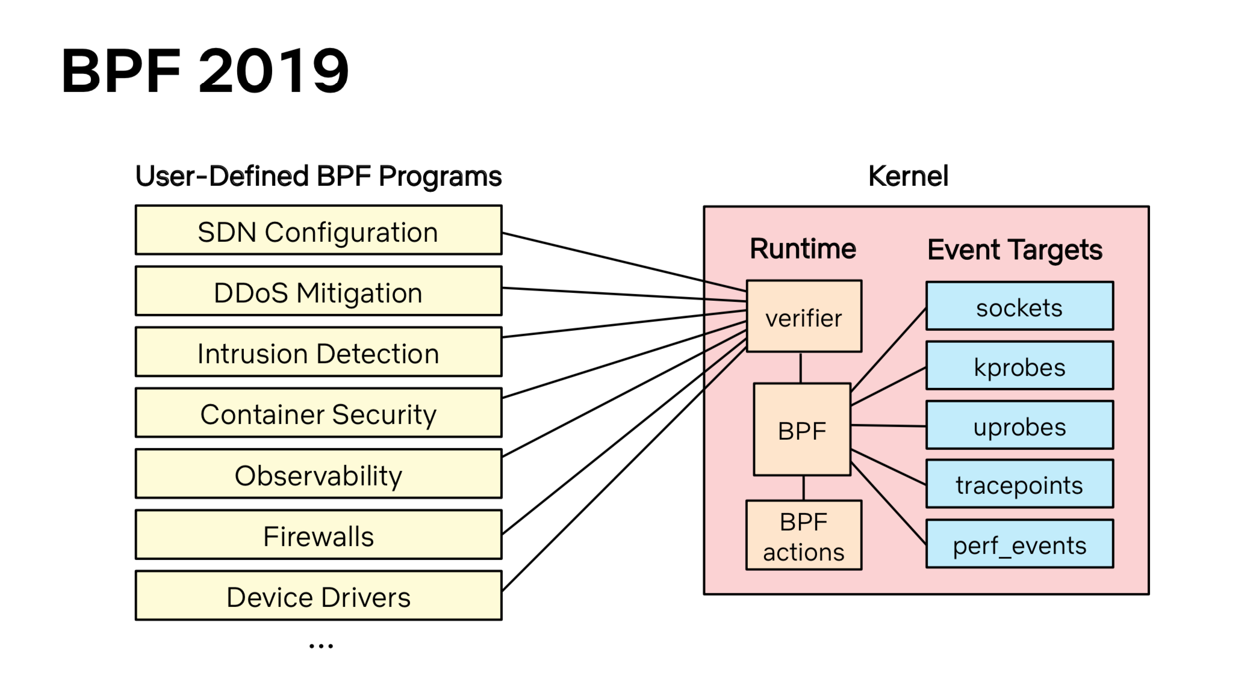

Slide 24
Question
Print the listing for a tcpdump program that filters for only TCP SYN packets.
What does line (006) do?

